Slide 1
Implementing Memory Ballooning Concept in OpenBSD Hypervisor
Project Advisor:
Mike Larkin
Team Members:
David P Montes
Hemaprasanthi Mutyala
Anjala Thulasiram
Ruchika Hazariwal

Slide 2
Agenda
Introduction
Problem Statement
Solution
Architecture Overview
Demo
Future Work

Slide 3
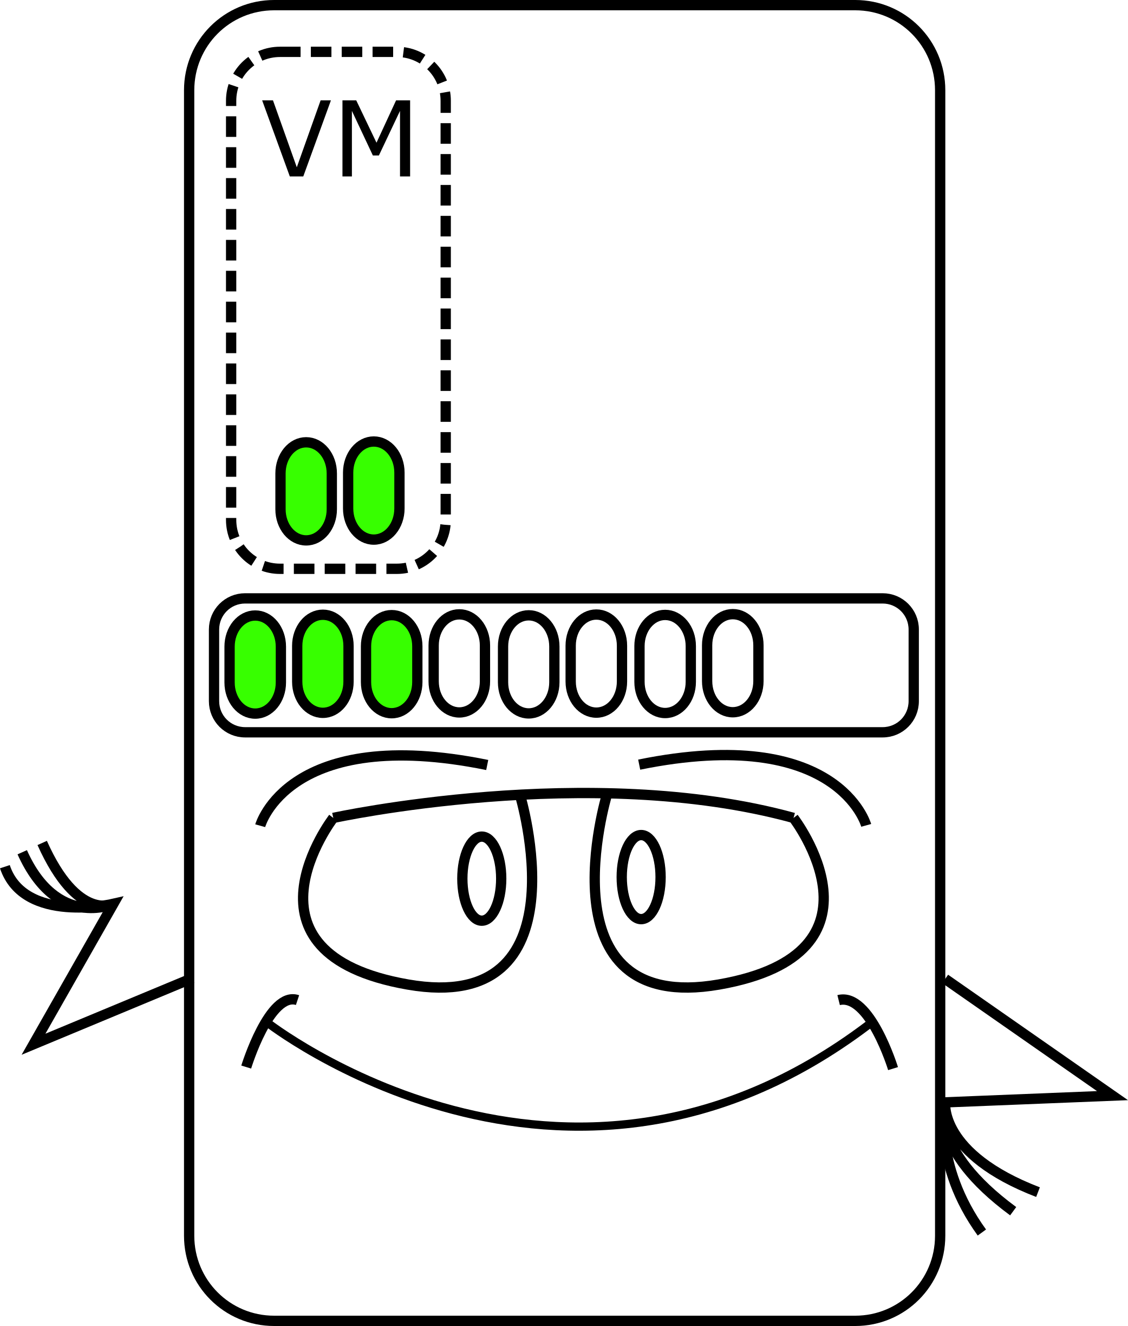
Introduction
The purpose of this project is to develop a dynamic memory management technique for the OpenBSD operating system’s hypervisor.
HYPERVISOR

Slide 4
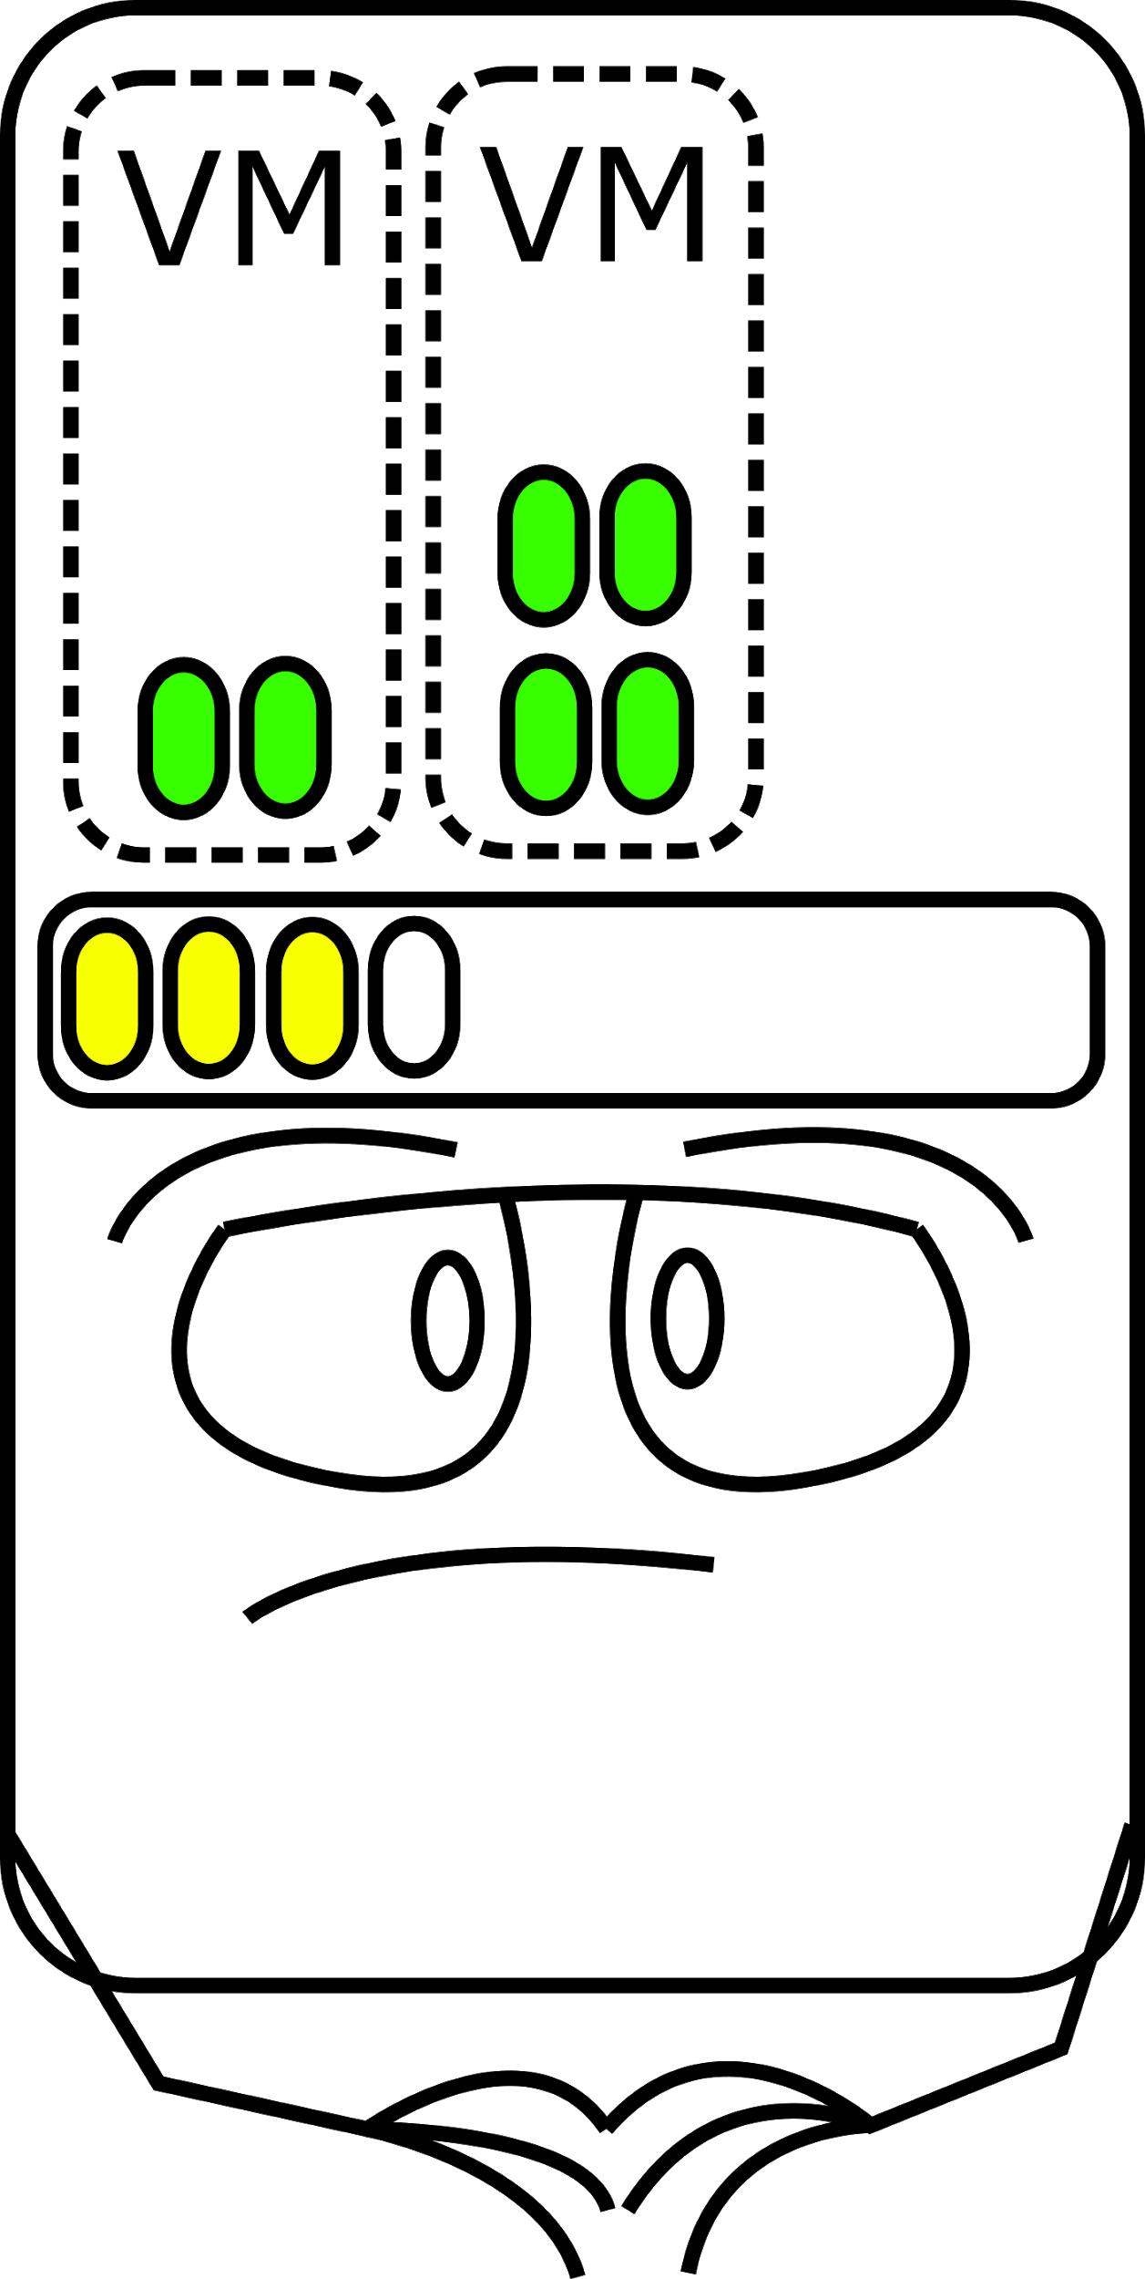
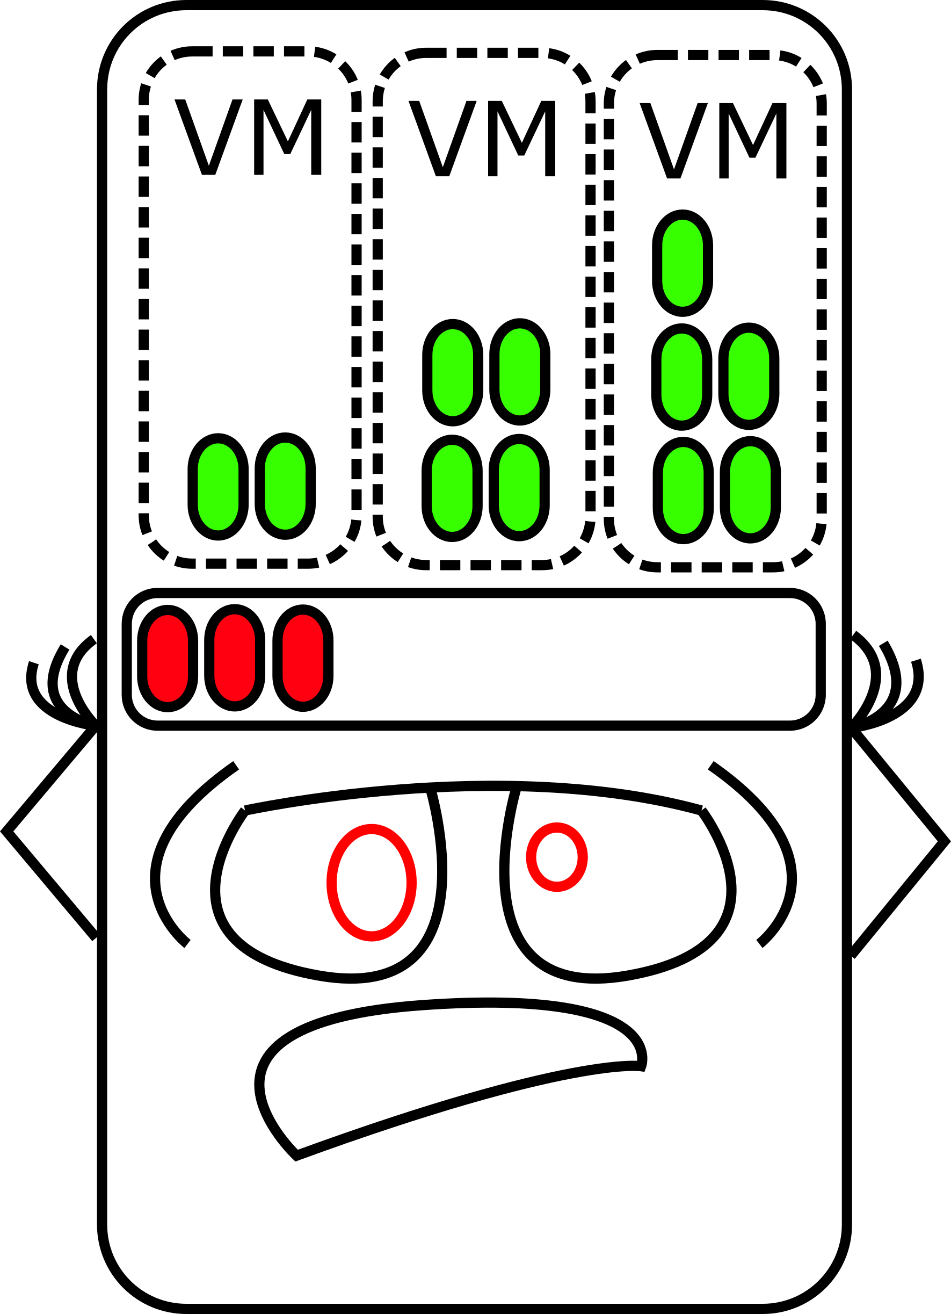
Problem Statement
The hypervisor must over commit its memory resources to support multiple guest virtual machines.
There must be a way for the hypervisor to temporarily reclaim some of that memory on demand or it will run out of memory.
HYPERVISOR
HYPERVISOR

Slide 5
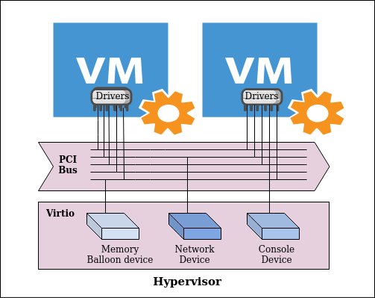
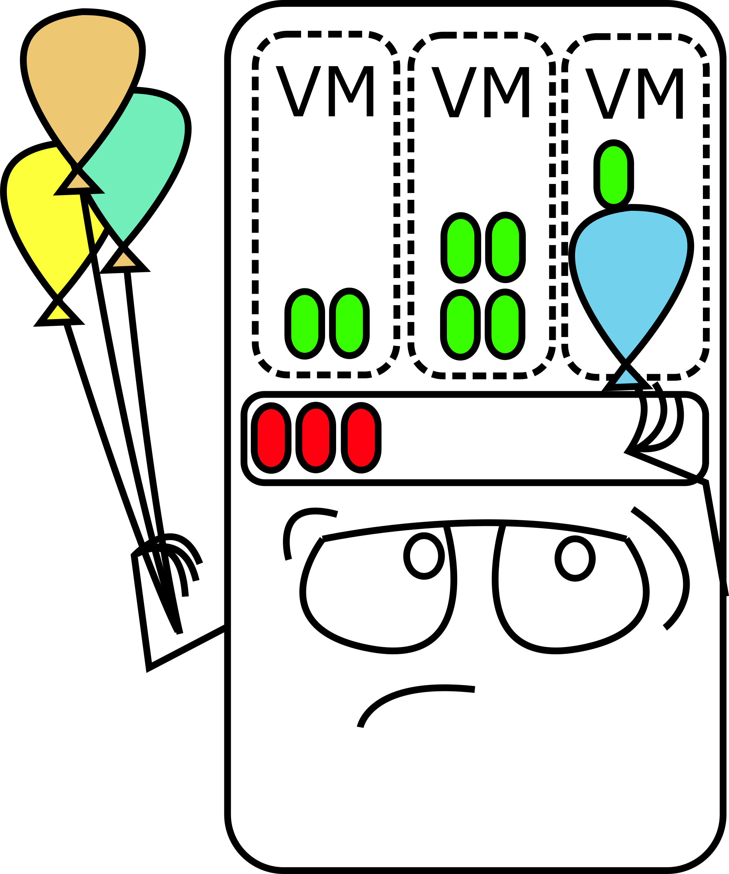
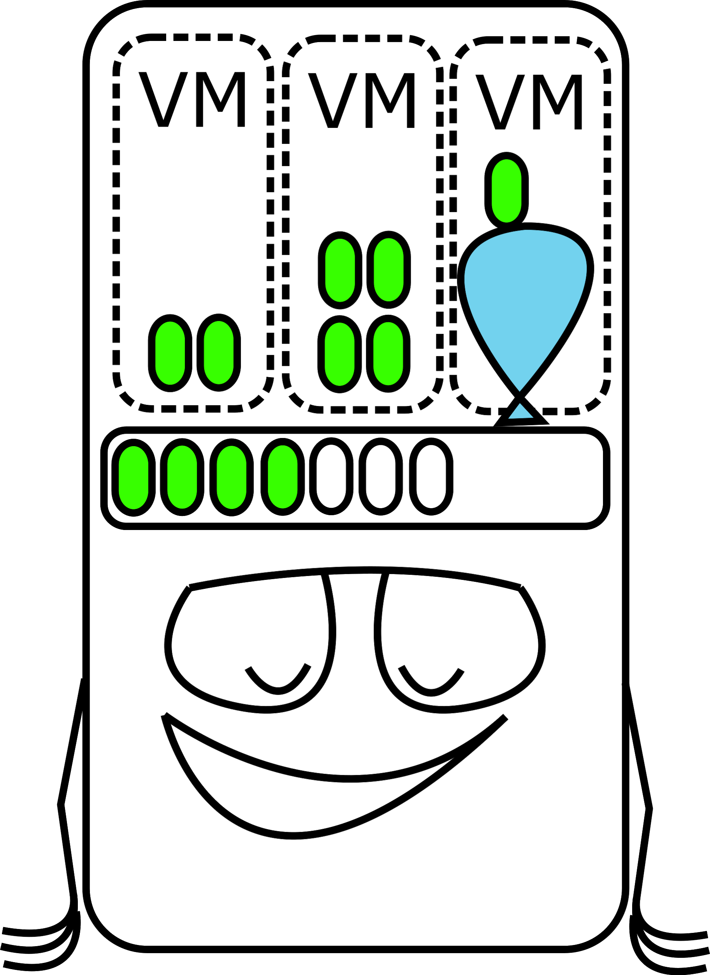
Solution
A new memory balloon device is added to the hypervisor which communicates with memory balloon drivers in the guests to exchange memory.
HYPERVISOR
HYPERVISOR

Slide 6
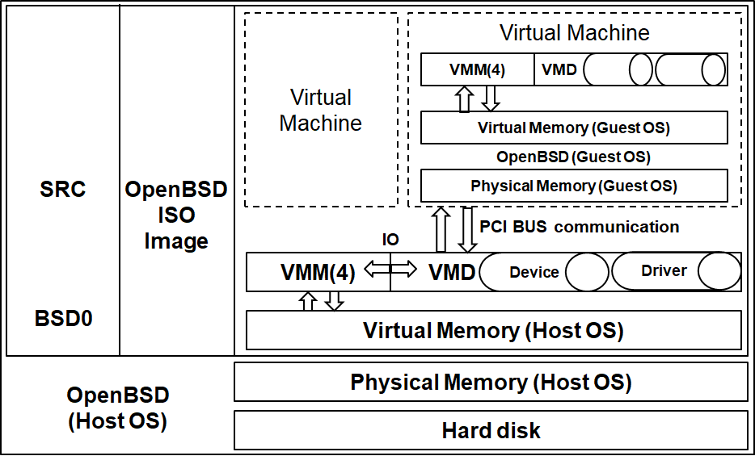
Architecture

Slide 7
Device Communication
Vring
(virtqueue WRITE)
Virtio Driver
(Guest)
Descriptor Table
Available
Used
Vring
(virtqueue READ)
Virtio Device
(OpenBSD)

Slide 8
Demo
Click here to see demo

Slide 9
Future Work
Optimizing memory reclamation algorithm
Running the balloon thread in parent VMD
Automate the process of sending deflate request from guest VM

Slide 10
Thank you!

